Slide 1
Department of MCA
Dr Shiva Kumar T
Assistant Professor
Presented by
Shashank Katti
1BY22MC047

Slide 2
Taking up a seminar on full stack development is highly motivating due to its pivotal role in today's technology landscape. The demand for developers who can seamlessly handle both front-end and back-end tasks is on the rise, making this a valuable and versatile skill. By delving into this topic, participants will gain insights into the extensive knowledge required, from designing user interfaces to managing databases and servers. Full stack development is integral to the industry as it streamlines the process of building and maintaining robust applications. This seminar will empower participants with a holistic understanding of full stack development, enhancing their ability to tackle complex projects and significantly boosting their employability in the competitive tech sector.

Slide 3
Full stack development is a crucial skill in today's technology landscape. The demand for versatile developers who can manage both the front-end and back-end aspects of applications is increasing. By exploring this topic, we can understand the breadth of knowledge required, the importance of full stack development in the industry, and how it shapes the way we build and maintain applications. This seminar aims to equip participants with a comprehensive understanding of full stack development, preparing them to tackle complex projects and improve their employability in the tech sector.
elaborate this for few lines

Slide 4
Importance of Full Stack Development:
Versatility: Full stack developers can work on all parts of a project, making them invaluable team members.
Cost-Effective: Hiring full stack developers can be more cost-efficient than hiring separate front-end and back-end developers.
Efficient Problem-Solving: With knowledge of both sides, full stack developers can diagnose and resolve issues more effectively.
Better Project Management: Understanding the entire stack allows for better project planning and management, ensuring smoother workflows.

Slide 5
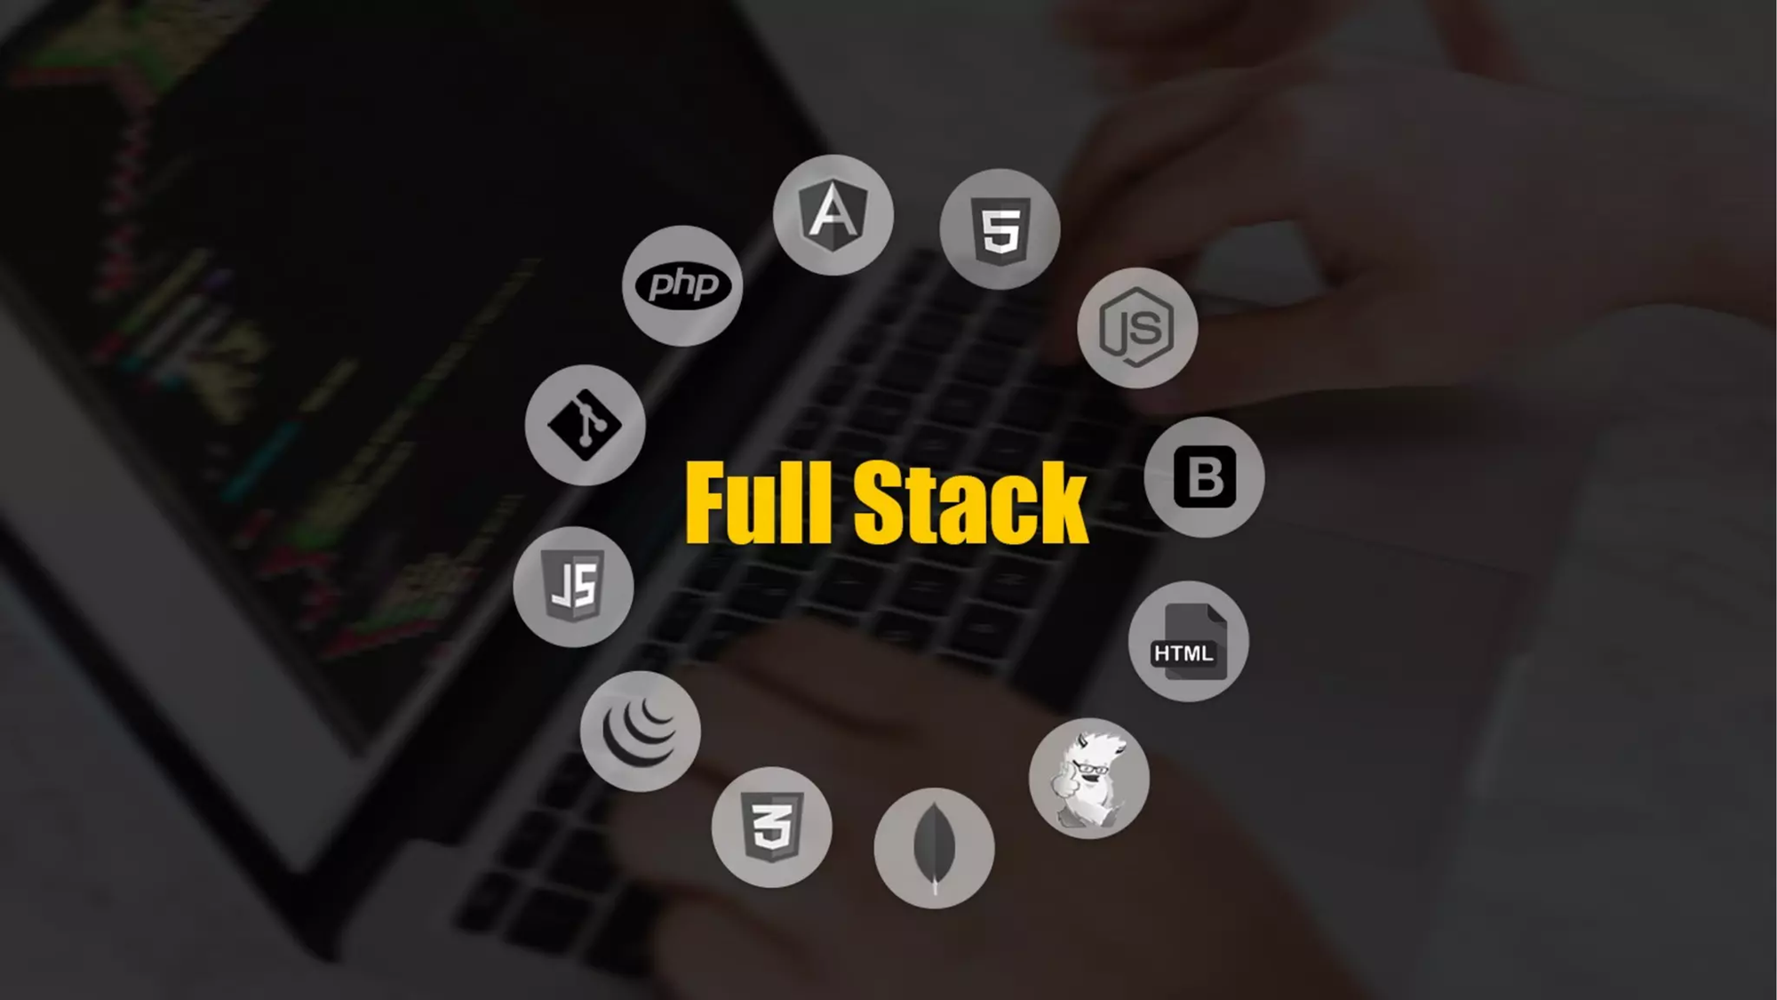

Slide 6
Introduction to Full Stack Development:
Full stack development refers to the practice of working on both the front-end (client side) and back-end (server side) portions of an application. A full stack developer has the skills to handle all aspects of application development, from designing user interfaces to managing databases and server logic. This role requires proficiency in multiple programming languages and technologies, making it a versatile and highly valuable position in the tech industry.

Slide 7
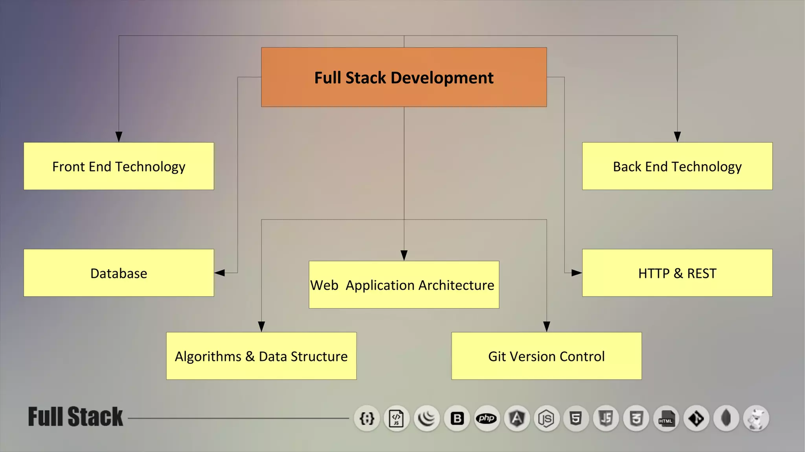

Slide 8
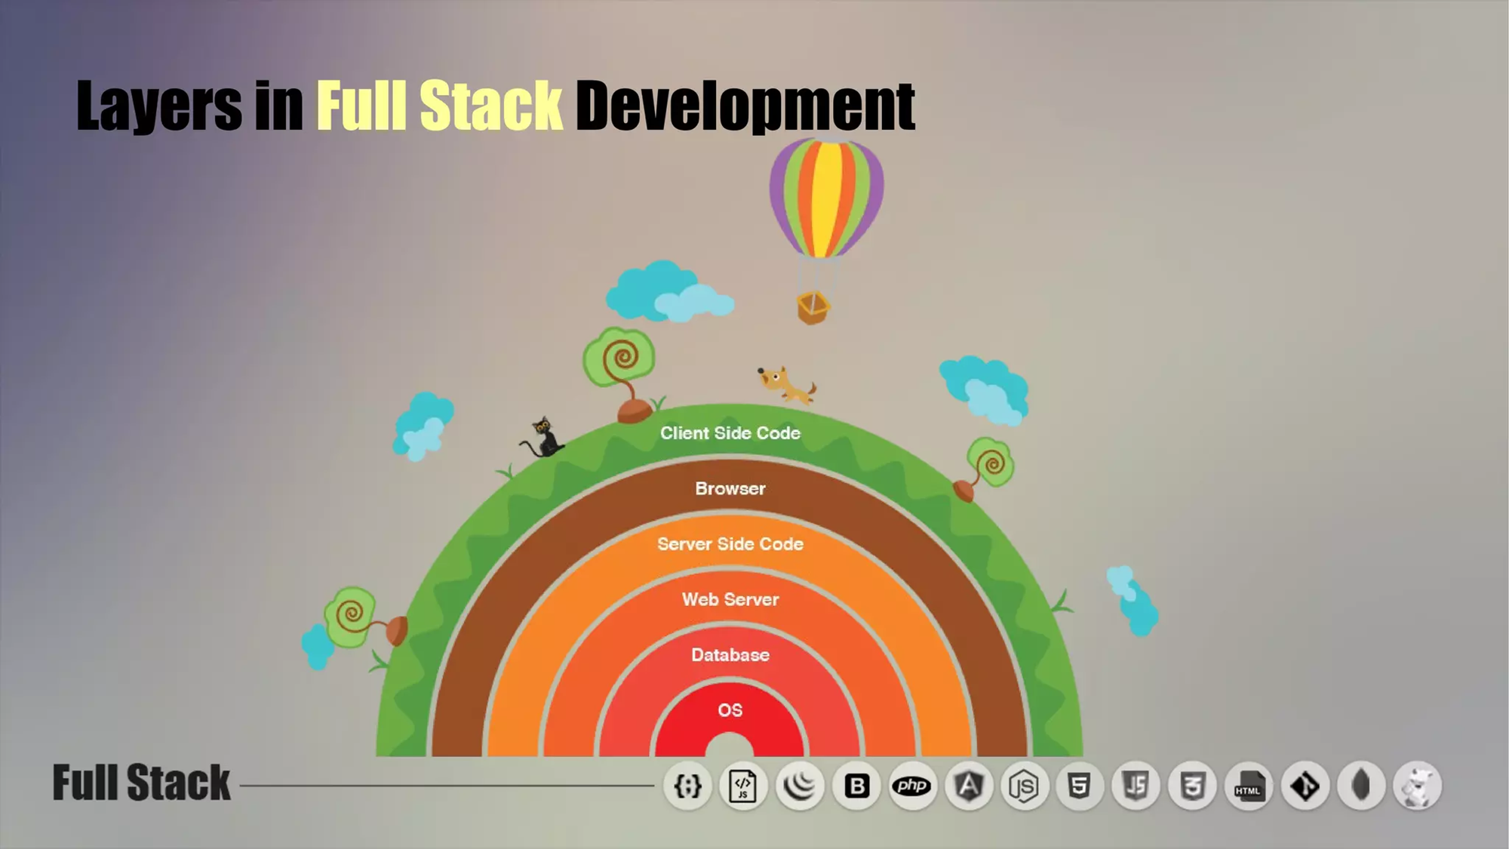

Slide 9
SECTION 1: Course Introduction
SECTION 2: Basic HTML Programming
SECTION 3: HTML Programming
SECTION 4: Styling with CSS
SECTION 5: Twitter Bootstrap Programming
SECTION 6: Basic JavaScript Concepts
SECTION 7: Python Programming Techniques
SECTION 8: Backend programming with Python (Django)

Slide 10
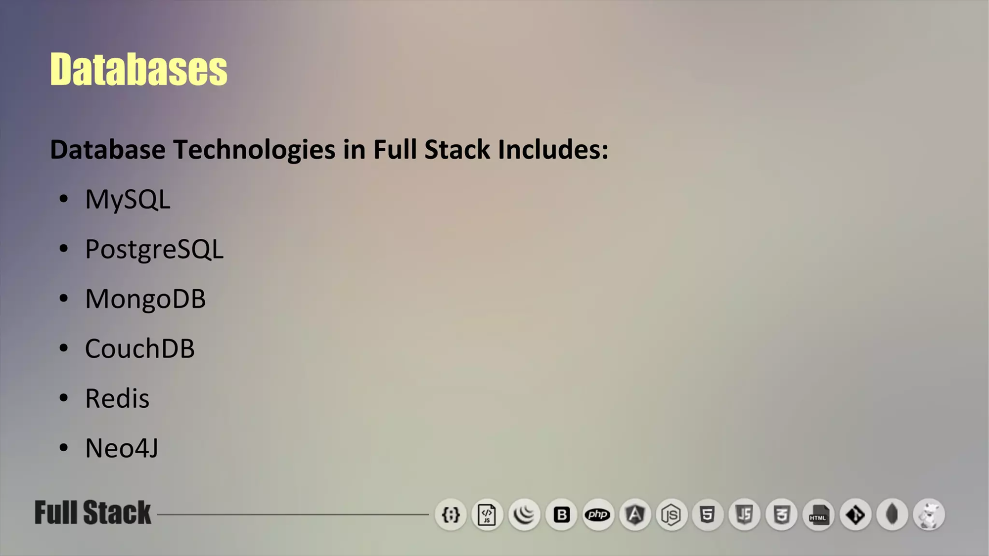

Slide 11
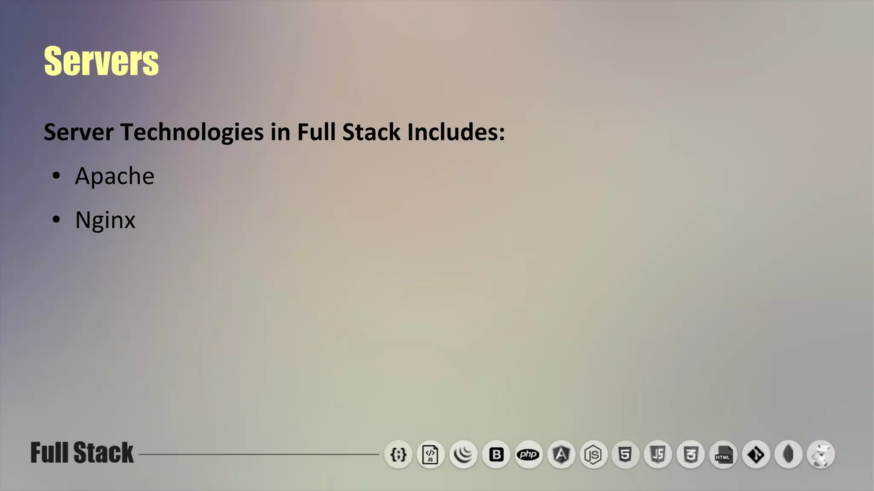

Slide 12


